Slide 1

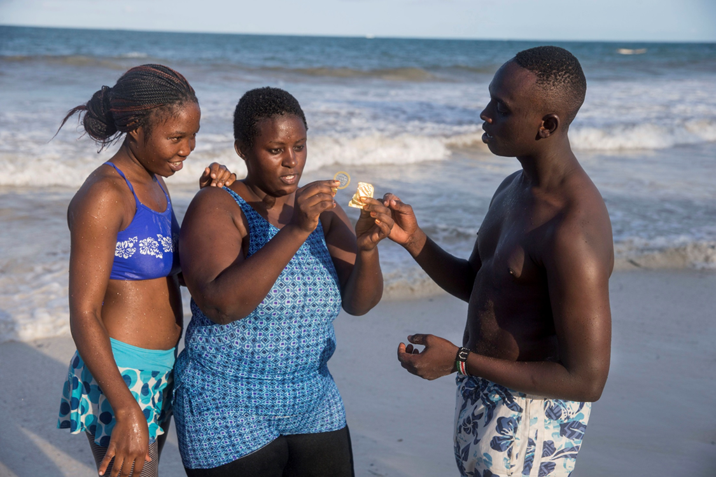
STI Control in the Context of the Global Health Agenda, the Sustainable Development Goals, and Universal Health Coverage
Dr Meg Doherty for
Dr Nono Simelela, World Health Organization
22nd July, 2018

Slide 2
STI Impact on Sexual and Reproductive Health
STI Mortality
STI Morbidity
370,000 adverse birth outcomes annually including 212,000 stillbirths and neonatal deaths due to congenital syphilis
266, 000 cervical cancer deaths each year due to HPV
STIs severely compromise people’s quality of life and of sexual life
1-2 million new cases of infertility annually if the 100 million of new chlamydia and gonorrhea infections in women are left untreated
HSV-2 infection: 3-fold increased risk of acquiring HIV
HSV-2 and HIV co-infection: more likely to transmit HIV
Curable STIs also increase HIV acquisition by 2- to 3-fold

Slide 3
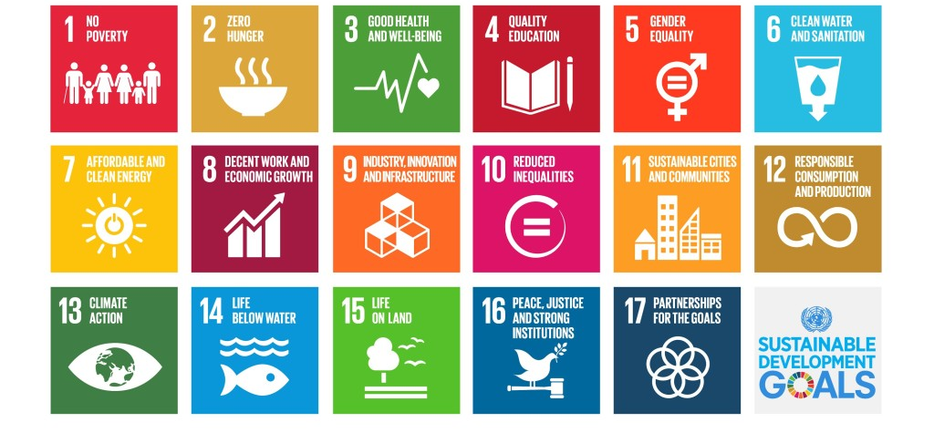
Addressing the Sustainable Development Goals

Slide 4
Contribution of STI Control to the SDG
2030 Health Targets
Overarching Health Goal #3 : Ensure healthy lives and promote well-being for all at all ages
2
Reduce Child and Neonatal Mortality
3
End Epidemics of AIDS, TB, Malaria, and NTDs, and Combat Hepatitis and Other Communicable Diseases
Health Targets
8
Universal Health Coverage, Including Financial Risk Protection
4
Reduce NCDs and Improve Mental Health
7
Sexual and Reproductive Health

Slide 5
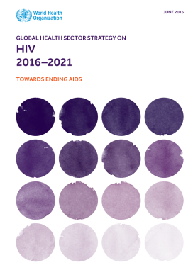
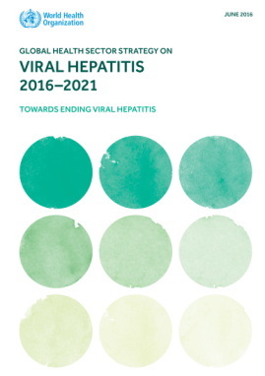
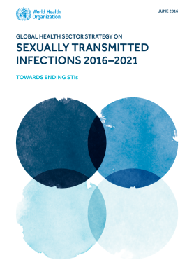
Three Interlinked Global Health Sector Strategies for HIV, Hepatitis and STI 2016-2021
With ambitious goals for ending AIDS, STI and viral hepatitis as public health threats by 2030 - endorsed during the 2016 World Health Assembly
Notes:
WHO has released three interlinked global health sector strategies for HIV, hepatitis and STI 2016-21 which were endorsed during the 68th World Health Assembly in 2016. The three strategies are designed to contribute to the attainment of the 2030 Agenda for Sustainable Development. All three strategies have ambitious goals for ending AIDS, STI and viral hepatitis as public health threats by 2030.
The STI strategy specifically has set the targets:
• 90% reduction of T. pallidum incidence globally (2018 global baseline);
• 90% reduction in N. gonorrhoeae incidence globally (2018 global baseline);
• 50 or fewer cases of congenital syphilis per 100 000 live births in 80% of countries;12
• Sustain 90% national coverage and at least 80% in every district (or equivalent
administrative unit) in countries with the human papillomavirus vaccine in their
national immunization programme.
Milestones 2020
• 70% of key populations for HIV have access to a full range of services relevant to sexually transmitted infection and HIV, including condoms

Slide 6
2: Reduce child and neonatal mortality
Eliminating mother-to-child transmission of syphilis in pregnant women
2
Reduce Child and Neonatal Mortality

Slide 7
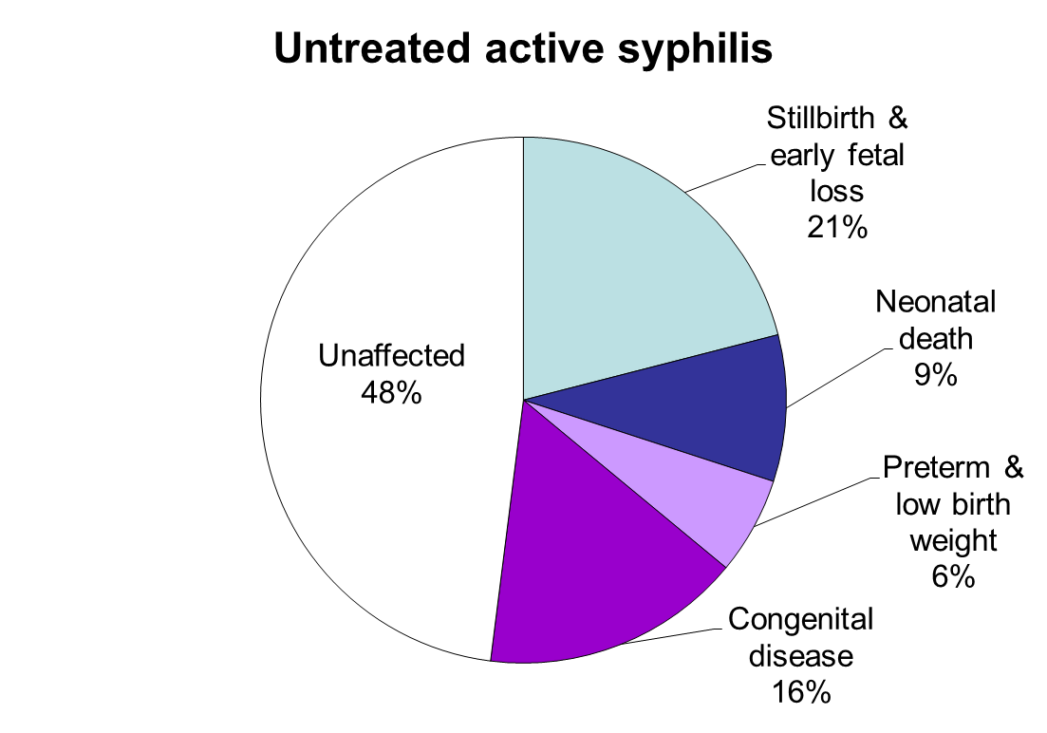
2: Reduce child and neonatal mortality
Syphilis Consequences in Pregnancy
52% of pregnant women infected with syphilis will have an adverse outcome if untreated
Globally, an estimated 370,000 adverse pregnancy outcomes were due to syphilis in 2016
Source: Gomez G et al, 2013. Korenromp et al under review, 2018

Slide 8
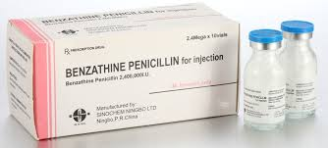
Cost-effective Interventions to Prevent Mother-to-Child Transmission of Syphilis
2: Reduce child and neonatal mortality
Screening of all pregnant women for syphilis early in antenatal care
  Rapid treponemal tests
  Rapid dual HIV/syphilis tests
Treatment of pregnant women with syphilis with benzathine penicillin
Partner treatment

Slide 9
Missed Opportunities To Prevent Adverse Birth Outcomes
2: Reduce child and neonatal mortality
Source: Korenromp EL, Rowley J, Newman L, Kamb M, Broutet N, Taylor MM et al. Under Review, June 2018

Slide 10
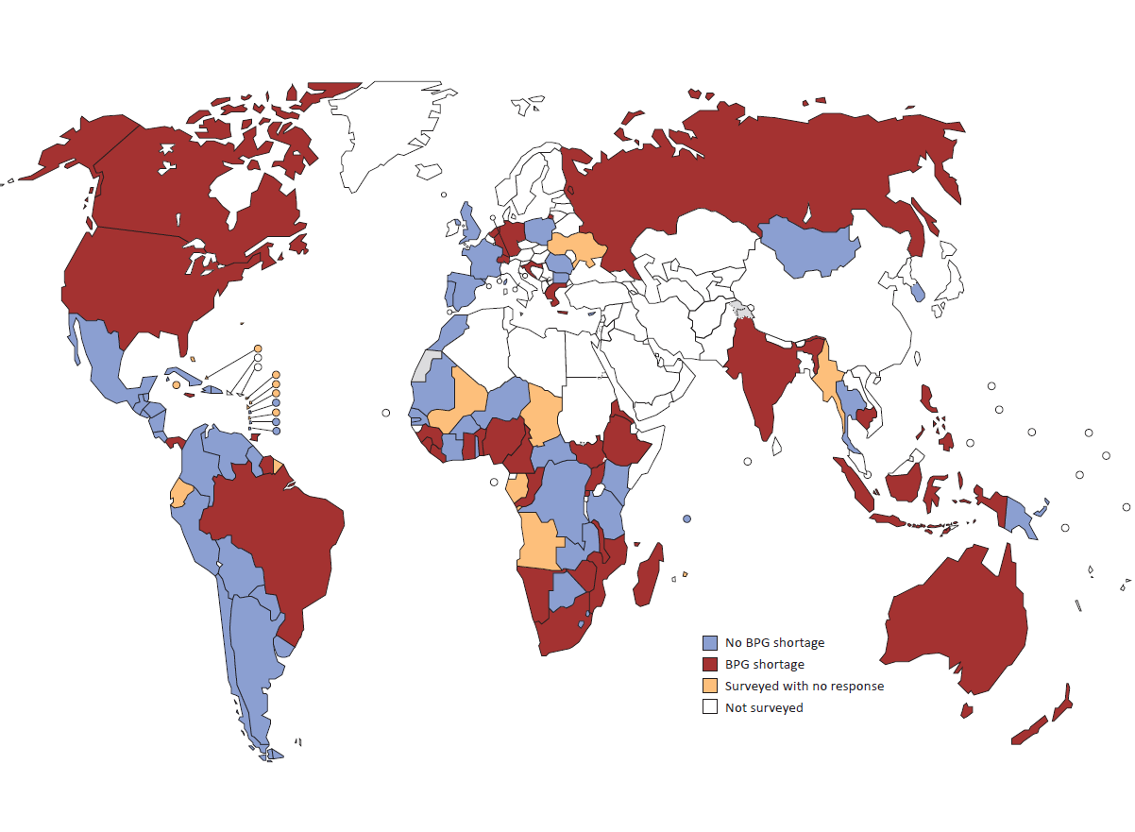
Benzathine Penicillin Shortages
40+ countries, 2014-2018
2: Reduce child and neonatal mortality

Slide 11
Priority Activities For Congenital Syphilis Prevention
2: Reduce child and neonatal mortality
Increase access to syphilis screening in antenatal care
Increase treatment coverage of syphilis-infected pregnant women with benzathine penicillin
Identify alternative treatment for pregnant women with syphilis
Support countries to achieve WHO validation of elimination of mother-to-child transmission of syphilis (10 countries validated)

Slide 12
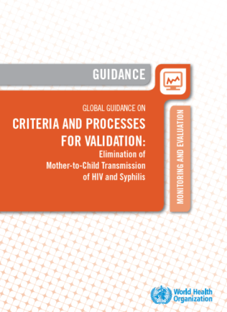
Validation of EMTCT:
core impact and process indicators
 | ELIMINATION
 | HIV | Syphilis
IMPACT criteria | Incidence ≤ 50 cases per 100,000 live births MTCT rate < 2% or < 5% in breastfeeding populations | Incidence ≤ 50 cases per 100,000 live births
PROCESS criteria | 1st ANC coverage ≥ 95% Testing coverage ≥ 95% ART coverage ≥95%* | 1st ANC coverage ≥ 95% Testing coverage ≥ 95% Treatment coverage >95%
*90% originally, revised to 95% in 2016
Source: Criteria and Processes for Validation. WHO 2014 http://www.who.int/hiv/pub/emtct-validation-guidance/en/
Notes:
2012 Consultation on
Global Guidance for EMTCT Validation
Standardized Criteria
Process
Secretariat
WHO, UNAIDS, UNICEF, UNFPA
Based on country pilots
Common systematic approach for dual elimination
For MTCT of HIV and syphilis, “elimination” was defined as “eliminating as a public health problem, to a very low level”
Credible, and systematic process was proposed in line with other elimination initiatives
Global Validation Advisory Committee established to support regional processes and activities
Criteria and tools have been developed
– Data quality assessment
– Laboratory quality assessment
– Human Rights and Community engagement
– Programme analysis tool

Slide 13
3: End epidemics of AIDS, TB, malaria and NTDs, and combat hepatitis and other communicable diseases
3
End Epidemics of AIDS, TB, Malaria, and NTDs, and Combat Hepatitis and Other Communicable Diseases
PrEP (Pre-Exposure Prophylaxis)
Tackling antimicrobial-resistant (AMR)
Neisseria gonorrhoeae

Slide 14
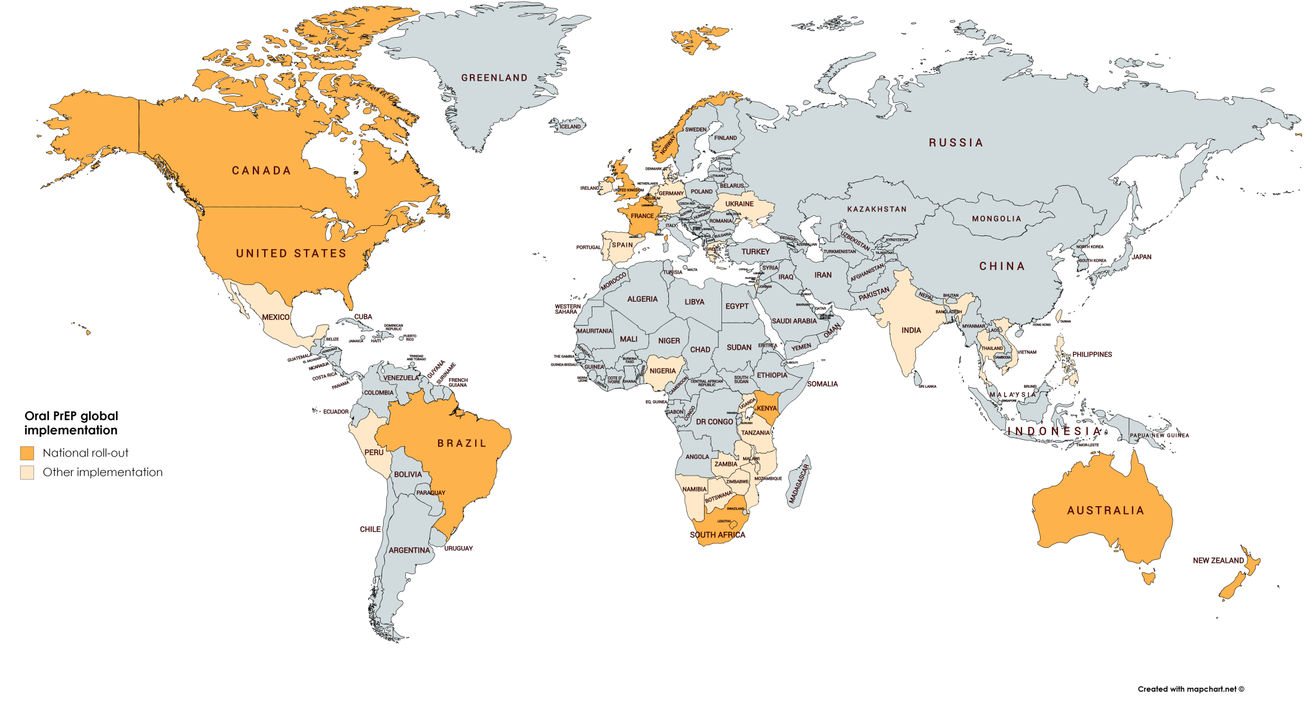
Oral PrEP Global Roll-Out, 2018
3: End epidemics of AIDS, TB, malaria and NTDs, and combat hepatitis and other communicable diseases
National rollout
Project Implementation (e.g. demonstration projects, pharmacy access, DREAMS)

Slide 15
3: End epidemics of AIDS, TB, malaria and NTDs, and combat hepatitis and other communicable diseases
STI Incidence in Persons Using PrEP
Kaiser-Permanente, San Francisco, USA
N=657
12-month cumulative STI percentages
  STI rates were high, but no HIV occurred, in one large PrEP program from the US
  Source: Volk et al. Clin Infec Dis 2015

Slide 16
Promoting sexual health in key populations and other groups
3: End epidemics of AIDS, TB, malaria and NTDs, and combat hepatitis and other communicable diseases
PrEP for HIV: Gateway for STI services
HIV testing
PrEP & condoms
SEXUAL HEALTH
STI services
STI screening and treatment
  HIV syphilis dual test
  PCR for gonorrhoea and chlamydia
  Opportunity to accelerate point-of-care test development
Partner management
Provision of quality sexual health services

Slide 17
Reported Decreased Susceptibility/Resistance To Current Treatment For Gonorrhoea, WHO GASP 2016
3: End epidemics of AIDS, TB, malaria and NTDs, and combat hepatitis and other communicable diseases
65 Countries Participating in Gonococcal Antimicrobial Surveillance Programme
Cephalosporins
33/63 (52%) countries decreased susceptibility
14 countries ≥ 5% isolates decreased susceptibility
Azithromycin
50/61 (82%) countries report resistance
29 countries ≥ 5% isolates resistant
Quinolones
64/65 (95%) countries report ciprofloxacin resistance
26 countries > 90% isolates resistant
63 countries > 5% isolates resistant
Source: Wi et al., PLOS Med

Slide 18

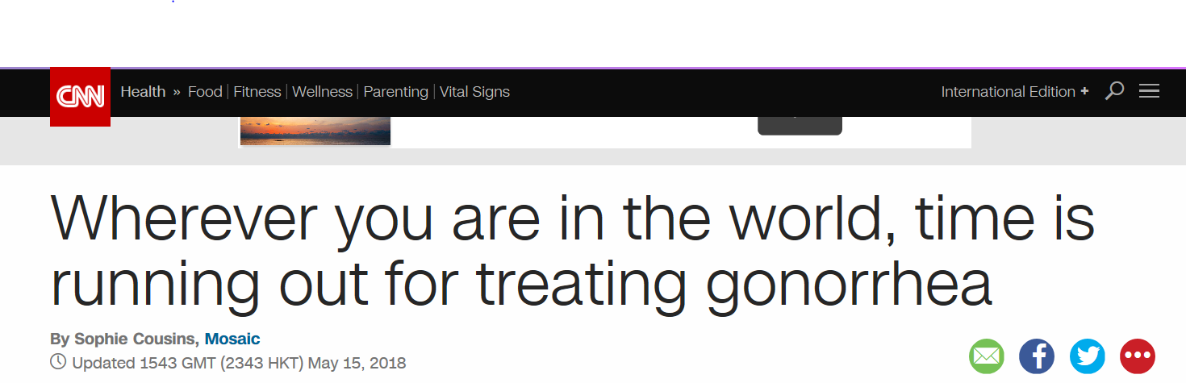
‘Man Has World’s Worst Super-gonorrhoea’, BBC News
(28 March 2018)
3: End epidemics of AIDS, TB, malaria and NTDs, and combat hepatitis and other communicable diseases
Evidence of global spread of gonococcal strains with high resistance to cephalosporins and azithromycin
  UK strain and similar strain detected in Australia
Japan strain with high resistance to cephalosporin reported in Australia, Canada and Denmark
Cases with history of contacts in South East Asia

Slide 19
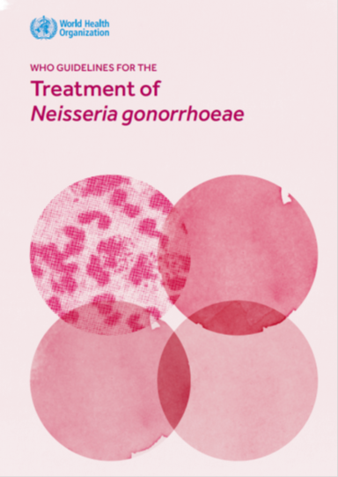
Response: Delaying Antimicrobial Resistance
3: End epidemics of AIDS, TB, malaria and NTDs, and combat hepatitis and other communicable diseases
Comprehensive STI case management
Enhanced monitoring of gonorrhoea AMR (EGASP) – to inform national and global treatment guidelines
Antibiotic and diagnostic stewardship
  Essential medicine list
    Drug conservation: access, but restricted
  Point-of-care test (POCT)
    Gonorrhoea diagnosis
    Molecular assay for AMR testing

Slide 20
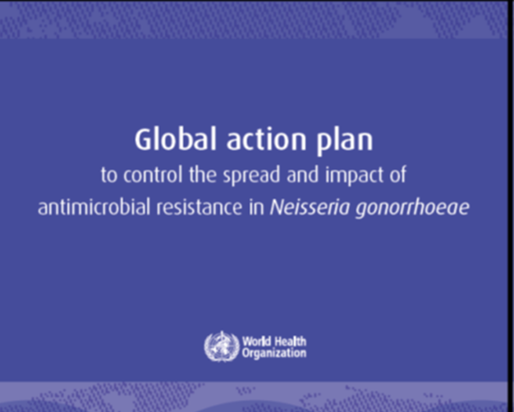
Global Action Plan to Control the Spread and Impact of AMR in Neisseria gonorrhoeae
3: End epidemics of AIDS, TB, malaria and NTDs, and combat hepatitis and other communicable diseases
Gonorrhoea Antimicrobial Surveillance to inform treatment guidelines and policy
STI Prevention and Control
Development of new gonorrhoea
treatment
POCT for gonorrhoea ID & AMR
detection
Facilitate gonorrhoea vaccine development
Notes:
Gono vaccine notes:
1. In the past, gonococcal vaccine development has lagged behind other STI vaccines
2. However, gonococcal AMR and recent data on meningococcal vaccine have jumpstarted efforts
3. A meningococcal OMV vaccine provides initial proof of concept for a gonococcal vaccine (Petousis-Harris, Lancet 2017)
- Used in New Zealand (2004-2008) to limit N. meningitidis type B (MenB) outbreak
- Large retrospective case-control study in 15-30 year-olds
- Estimated 31% vaccine effectiveness against gonorrhoea
- Work is ongoing to evaluate this further and expand development approaches based on findings
4. Through an initial funding from BactiVac Catalyzing Funds (University of Birmingham and UK Overseas Development Agency), WHO with Thailand, South Africa and London School of Hygiene Collaborators is organizing a meeting in December 2018 to:
- Develop strategy on gonorrhoea vaccine development
- Determine how will the gonorrhoea vaccine look like?

Slide 21
4: Reduce NCDs and Improve
Mental Health
4
Reduce NCDs and Improve Mental Health
Elimination of cervical cancer: HPV vaccination and screening

Slide 22
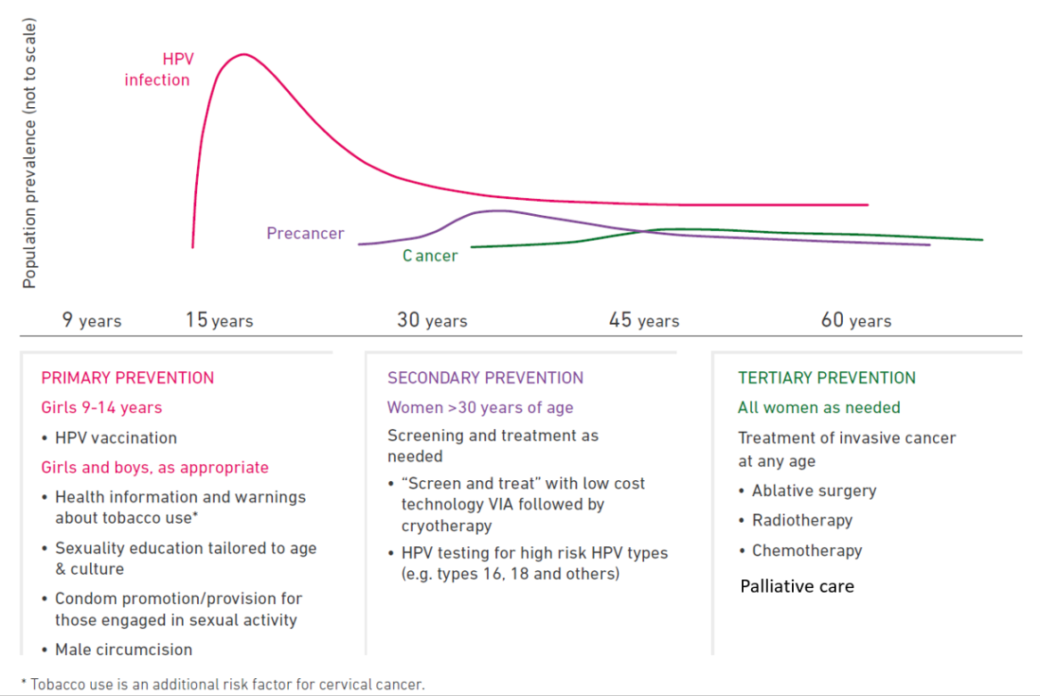
Life Course Approach Towards Elimination of Cervical Cancer
4: Reduce NCDs and improve mental health
Primary Prevention
Secondary Prevention
Tertiary Prevention
Girls 9-14 years
  HPV vaccination
Girls and boys, as appropriate
Health information and warnings about tobacco use
Sexuality education tailored to age & culture
Condom promotion/provision for those engaged in sexual activity
Male circumcision
Women > 30 years of age
HPV testing for high risk HPV types
Followed by immediate treatment
Point-of-care test
On site treatment
All women as needed
Treatment of invasive cancer at any age
Ablative surgery
Radiotherapy
Chemotherapy
Palliative Care
Notes:
The strategic direction 2, highlights the 3 key WHO recommendations to be implemented at scale in countries based on a life course approach, as represented on this figure:
- HPV vaccination;
- Screening and treatment;
- Treatment of cancer and access to palliative care.
For vaccination, the vaccine group in WHO is currently looking at new evidence available to update the recommendation if needed, and to present findings to the next SAGE meeting
For screening and treatment: new recommendations are going to be published on thermal ablation and screening amog HIV positive women. The strategy will focus on the extensive implementation of one of the recommended algorithm: HPV testing followed by immediate treatment for women tested positive in a single visit approach
As more cancer will be identified in the context of an intensive screening campain, strengthen access to reatment and palliative care is essential

Slide 23
Countries with HPV Vaccination in the National Immunization Programme
4: Reduce NCDs and improve mental health
Introduced* to date
(80 countries or 41%)
Not Available,
Not Introduced/No Plans
(114 countries or 59%)
Not applicable
* Includes partial introduction
Source: WHO/IVB Database, as of 15 May 2018
Notes:
Introduced* to date
Andorra, Argentina, Australia, Austria, Bahamas, Barbados, Belgium, Belize, Bhutan, Bolivia, Botswana, Brazil, Brunei Darussalam, Canada, Chile, Colombia, Cook Islands, Croatia, Cyprus, Czech Republic, Denmark, Ecuador, Estonia, Fiji, Finland, France, Guatemala, Germany, Greece, Guyana, Honduras, Hungary, Iceland, Ireland, Israel, Italy, Jamaica, Japan, Latvia, Libya, Lithuania, Luxembourg, Malaysia, Malta, Marshall Islands, Mexico, Micronesia (Federated States of ), Monaco, Netherlands, New Zealand, Norway, Palau, Panama, Paraguay, Peru, Philippines, Portugal, Republic of Korea, Russian Federation, Rwanda, Saint Vincent and the Grenadines, San Marino, Sao Tome Y Principe, Seychelles, Singapore, Slovenia, South Africa, Spain, Sri Lanka, Suriname, Sweden, Switzerland, Thailand, The former Yugoslav Republic of Macedonia, Trinidad and Tobago, Turkmenistan, Uganda, United Kingdom, United States of America, Uruguay
Not Available,
Not Introduced/No Plans
Afghanistan, Albania, Algeria, Angola, Antigua and Barbuda, Armenia, Azerbaijan, Bahrain, Bangladesh, Belarus, Benin, Bosnia and Herzegovina, Bulgaria, Burkina Faso, Burundi, Cabo Verde, Cambodia, Cameroon, Central African Republic, Chad, China, Comoros, Congo, Costa Rica, Côte d'Ivoire, Cuba, Democratic People's Republic of Korea, Democratic Republic of the Congo, Djibouti, Dominica, Dominican Republic, Egypt, El Salvador, Equatorial Guinea, Eritrea, Ethiopia, Gabon, Gambia, Georgia, Ghana, Grenada, Guinea, Guinea-Bissau, Haiti, India, Indonesia, Iran (Islamic Republic of), Iraq, Jordan, Kazakhstan, Kenya, Kiribati, Kuwait, Kyrgyzstan, Lao People's Democratic Republic, Lebanon, Lesotho, Liberia, Madagascar, Malawi, Maldives, Mali, Mauritania, Mauritius, Mongolia, Montenegro, Morocco, Mozambique, Myanmar, Namibia, Nauru, Nepal, Nicaragua, Niger, Nigeria, Niue, Oman, Pakistan, Papua New Guinea, Poland, Qatar, Republic of Moldova, Romania, Saint Kitts and Nevis, Saint Lucia, Samoa, Saudi Arabia, Senegal, Serbia, Sierra Leone, Slovakia, Solomon Islands, Somalia, South Sudan, Sudan, Swaziland, Syrian Arab Republic, Tajikistan, Timor-Leste, Togo, Tonga, Tunisia, Turkey, Tuvalu, Ukraine, United Arab Emirates, United Republic of Tanzania, Uzbekistan, Vanuatu, Venezuela, Viet Nam, Yemen, Zambia, Zimbabwe

Slide 24
Cervical cancer screening (WHO STEP Survey): proportion of women between 30 – 49 screened for cervical cancer at least once

Slide 25


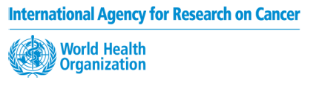
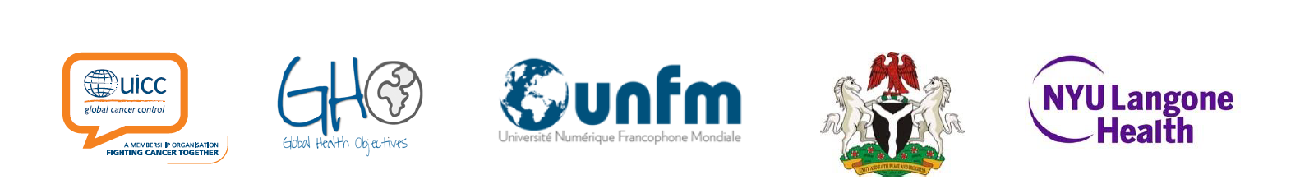

Call to action towards
Elimination of Cervical Cancer
Notes:
So the call to action made on 19 May by the WHO Director-General is critical to define a path forward and engage with partners and member states, to overcome the challenges and scale-up cost-effective interventions.
Coordinated action globally is needed to eliminate cervical cancer.
Already many partners have endorsed this call to action, as per the many logo you can see on this slide, but we are also reaching out to more partners to join forces.
As many partners are already working towards contributing to this goal, the key message of the call to action was that this should be done in a more coordinated manner in order to accelerate progress.
The WHO DG Recognized that several countries and UN agencies have already moved forward under the UN Global Joint Programme on Cervical Cancer Prevention and Control, however, he insisted that to succeed, we need everyone on board, and that we must expand our partnership to include anyone and everyone who can help us reach our goal.

Slide 26
7: Sexual and Reproductive Health
Addressing STIs through an integrated approach
7
Sexual and Reproductive Health

Slide 27
7: Sexual and Reproductive Health
Integration of services
Proposed linkages
Existing services
Family planning services
Expected outcome
Antenatal care (ANC)
Increased access to prevention and care
Primary health care (PHC) services
HIV/STI services
Improved quality of sexual and reproductive health services
Cervical / breast cancer screening
HIV testing services
Behaviour interventions

Slide 28

7: Sexual and Reproductive Health
Challenge: Majority of STIs Are Asymptomatic

Slide 29
Interventions for STI Control
8: Universal Health Coverage
High Risk Groups
(Incl. MSM, Sex Workers)
Women and Men Attending Primary Health Care
Women and Men in Community
STI screening with
point-of-care tests
Syndromic STI manage-ment
Risk-based
STI screening with point-of- care tests
Advocacy
Health Education and Counselling
Notes:
Syndromic case management
1. Near point-of care test for gonorrhoea and chlamydial infections are currently being developed, to reduce challenges in STI case management and ensure treatment at first contact with STI patients. Point of care test will improve effectiveness of syndromic management. However they will not be available and affordable in the near future in majority of primary health care settings, where majority of STI patients seek care.
2. STI syndromic approach is still widely used in high and low income countries.
3. WHO is revising syndromic case management guidelines which aims to raise the quality of STI case management and not promote suboptimal care.
4. Revision is underway to address its limitations:
- Overtreatment - becoming increasingly crucial because of the worsening antimicrobial resistance and limited treatment options.
- Limitation in management of cervical infection in women and anorectal infections (e.g. vaginal discharge syndrome for treatment of vaginal infection, but not cervical infection)
- Improve its effectiveness and potential role of.
- Role of Mycoplasma genitalium
5. Timeline
- Systematic reviews underway (2018)
- Modelling work to determine effectiveness of different approaches based on different service delivery settings (2019)
- Consultation of experts (2019)
- Release new guidelines by the beginning of 2020 (to consider approval process within the Guideline Review Committee of WHO)

Slide 30
8: Universal Health Coverage
STI control and the 3 dimensions of the UHC
8
Universal Health Coverage, Including Financial Risk Protection

Slide 31
Universal Health Coverage Framework
Interventions for impact
Delivering for equity
1. Integration of STI services with PHC, HIV, FP, MCH, adolescent, fertility
2. Reach key and specific populations
3. Community involvement
4. Quality of care
Financing
Develop an investment case
Support financial protection schemes
Reduce commodity prices
Increase procurement efficiency
1. Health education, HPV vaccine, condoms
2. Early diagnosis and treatment
3. Partner treatment
1. EMTCT of syphilis & HIV
2. HPV vaccines
3. Control gonococcal AMR

Slide 32
Conclusion:
An integrated STI response will have impact on…
Combating antimicrobial resistance
Eliminating adverse neonatal outcomes
Reducing HIV transmission
Preventing cancer
Supporting health of population esp. young people
Decreasing burden of infertility
… and will accelerate the SDG Agenda
Source: Daniel McCartney (IPPF)

